Slide 1
An Analysis of Parking Citations in Baltimore
Tamara Monge
Capstone 1
Springboard Data Science
May 23, 2018

Slide 2
The Project
Parking citations
Indicator of lack of legal parking options
Non-negligible source of revenue for cities
Project outcomes
Identify solutions for most pressing parking problems
Predict which parking citations will be paid, given features of the citations

Slide 3
The Clients
City Planners
Patterns in citations will indicate where more parking is needed
Will also suggest solutions
City Treasury
Predicting which fines will be paid will improve budgeting accuracy

Slide 4
The Data
Freely available at Open Baltimore
Fields: date, time and address of incident
violation description, code
citation number
license plate number, state
vehicle make
fine amount
account balance
Each download contains 2 temporal cohorts:
1. All citations issued over past two years (rolling, updated daily)
2. Any citations more than two years old with outstanding balance
Two downloads (Sept. 23, 2017, Nov. 30, 2017)
n = 912, 308 records (650 MB)

Slide 5
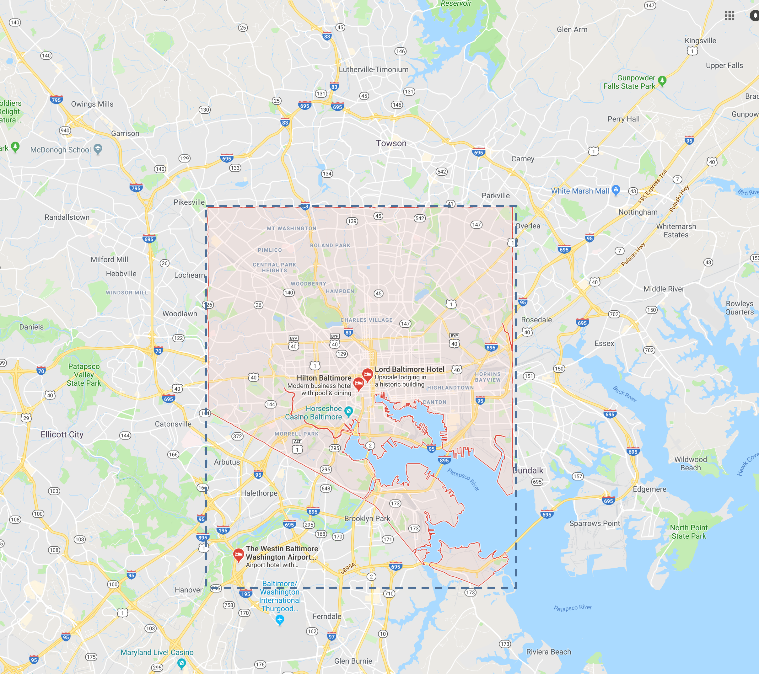
Wrangling Steps
Dataframe index = date
Extracted yr, mo, day, hr, lat, lon
Numerical features: string > float
Categorical features: text cleaning
Three new features
paid: binary indicating whether balance = $0
instate: binary indicating if state = MD
quad: categorical indicating quadrant containing (Lon, Lat)
Dropped records missing (Lon,Lat) (30%)
Removed extraneous records (< 3%)

Slide 6
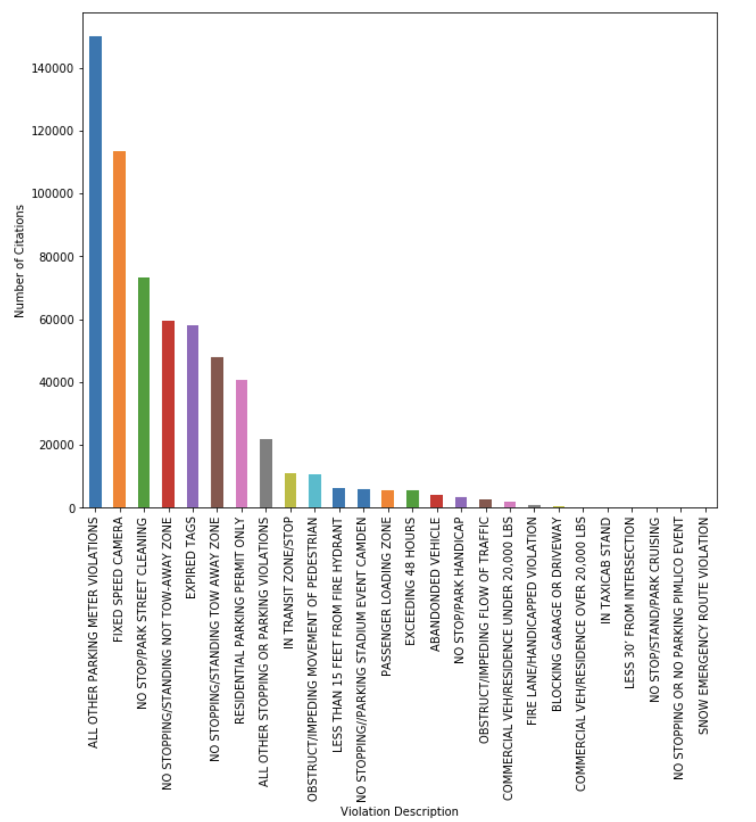
Exploratory Data Analysis
What?

Slide 7
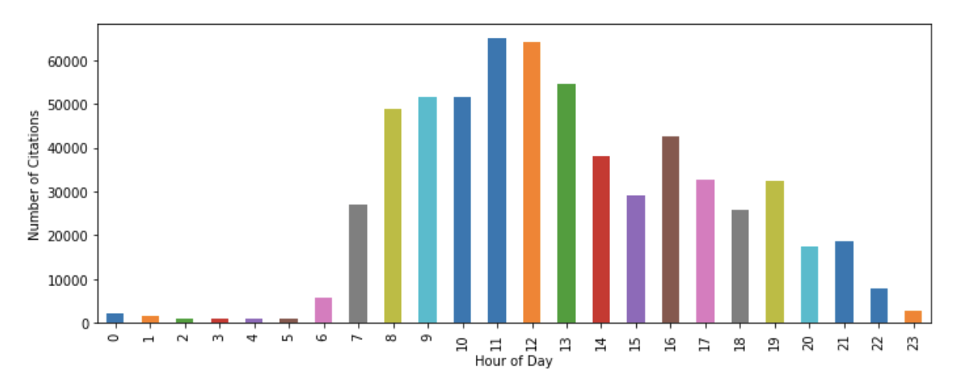
Exploratory Data Analysis
When?

Slide 8
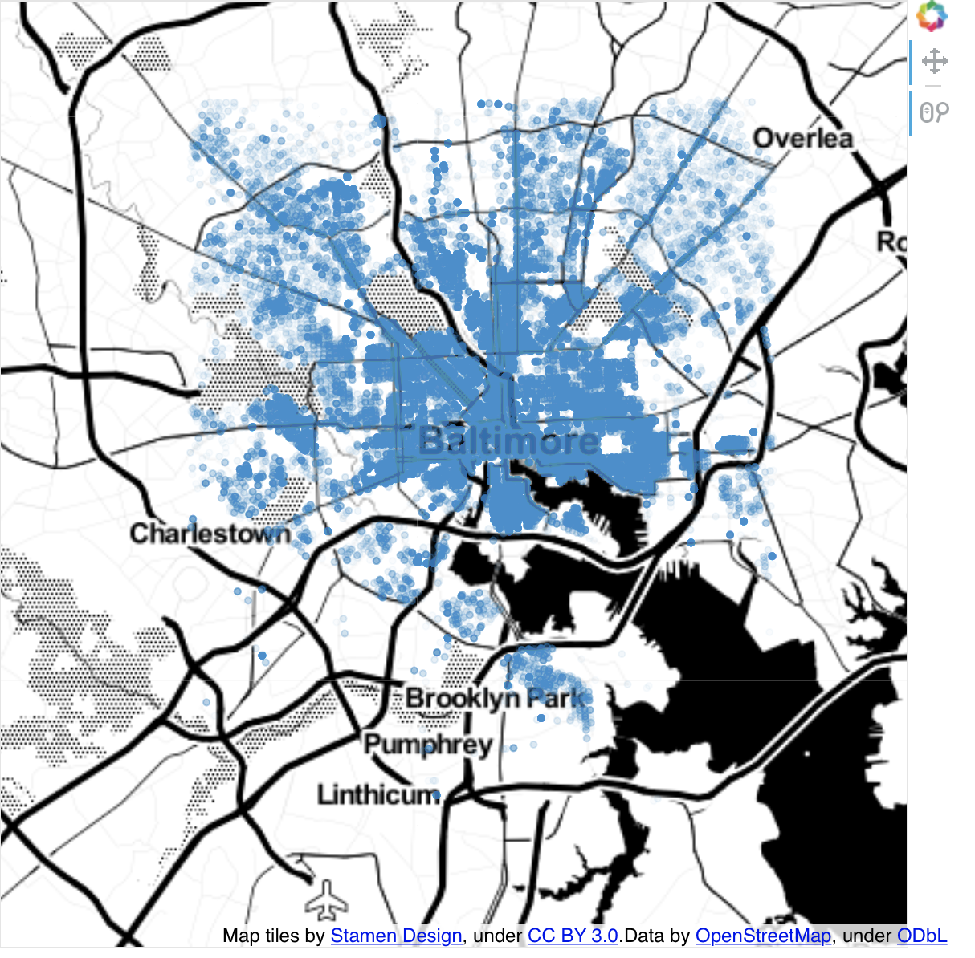
Exploratory Data Analysis
Where?

Slide 9
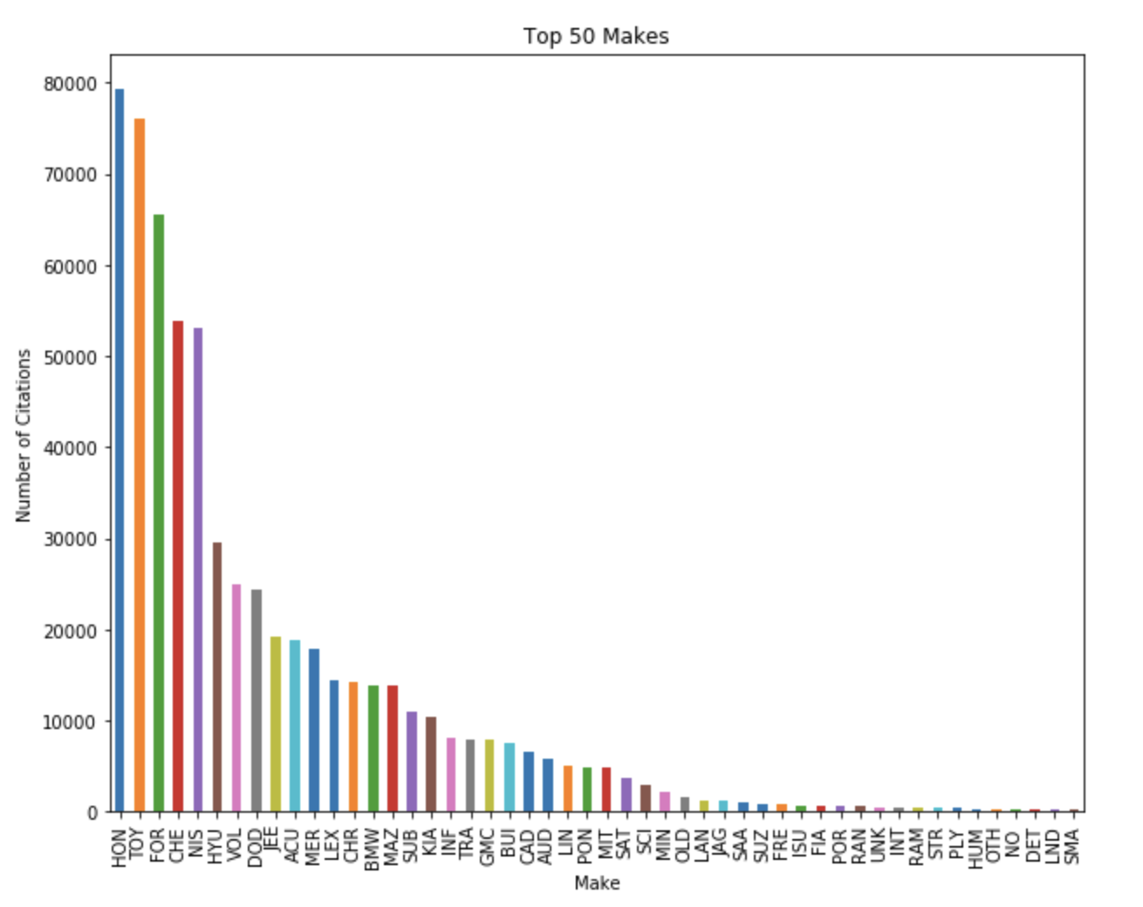
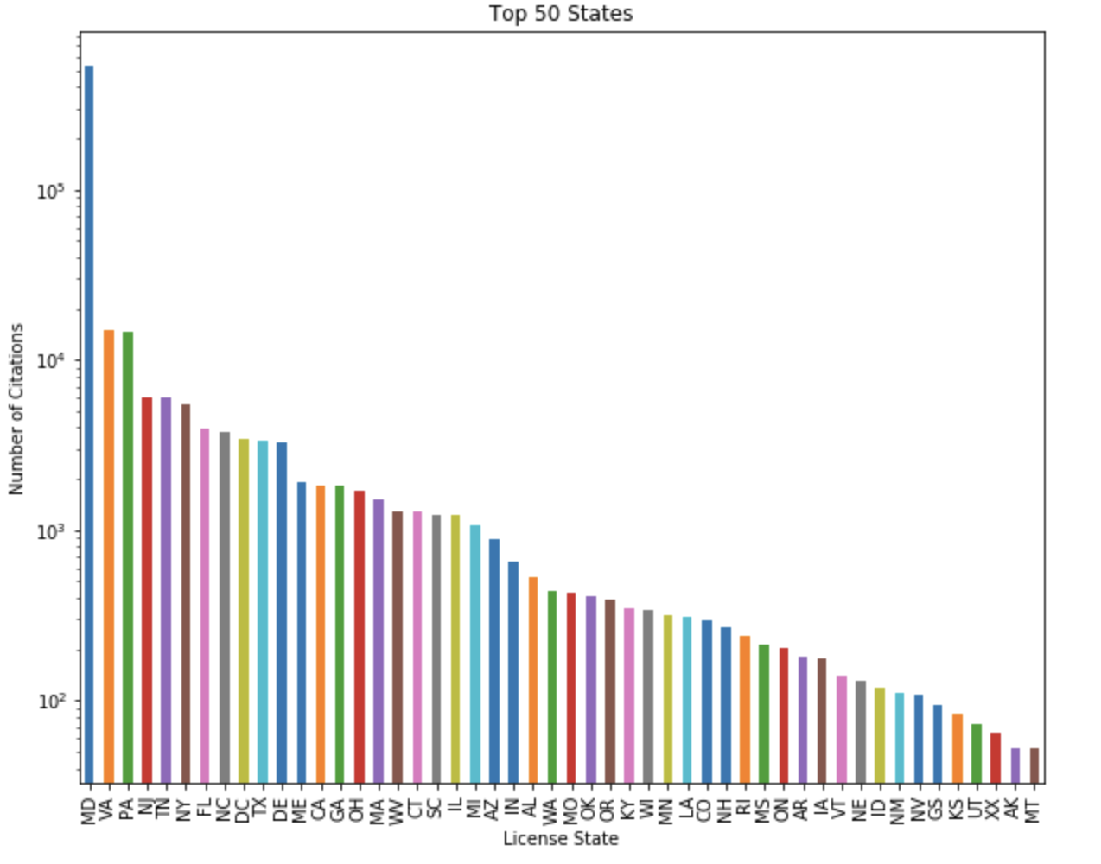
Exploratory Data Analysis
Who?

Slide 10
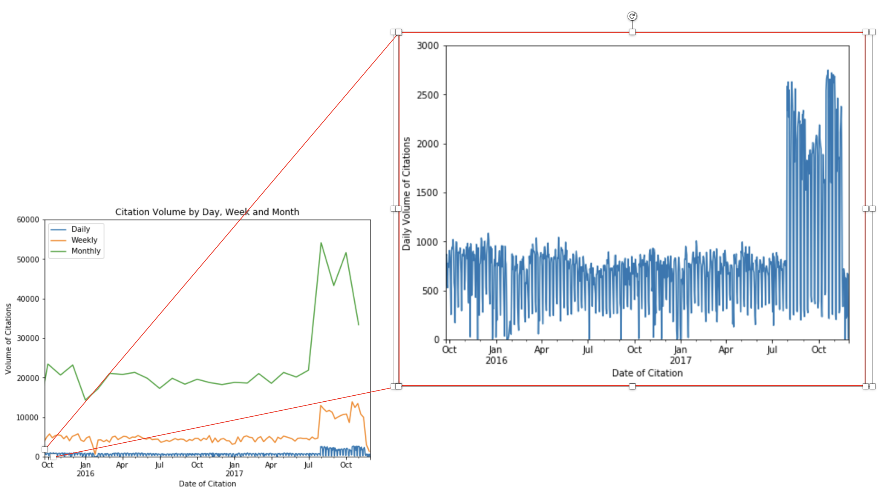
Exploratory Data Analysis
How Many?

Slide 11
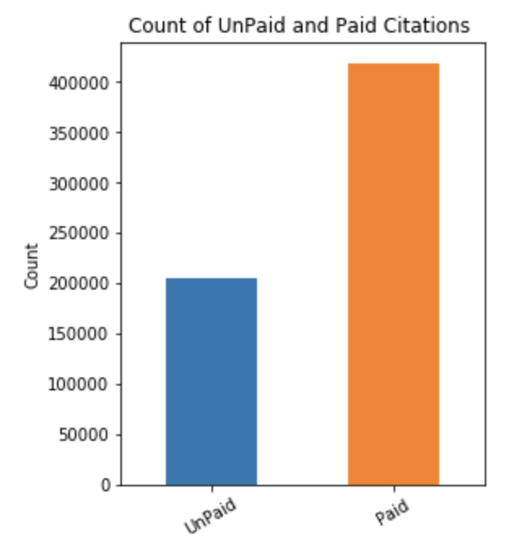
Supervised Classification
y = paid
X = [fine, desc, instate, make,
quad, yr, mo, day, hr]
Converted categorical variables to dummies.
Increased feature-space from 9 to 411.
H_{o} = 0.67

Slide 12
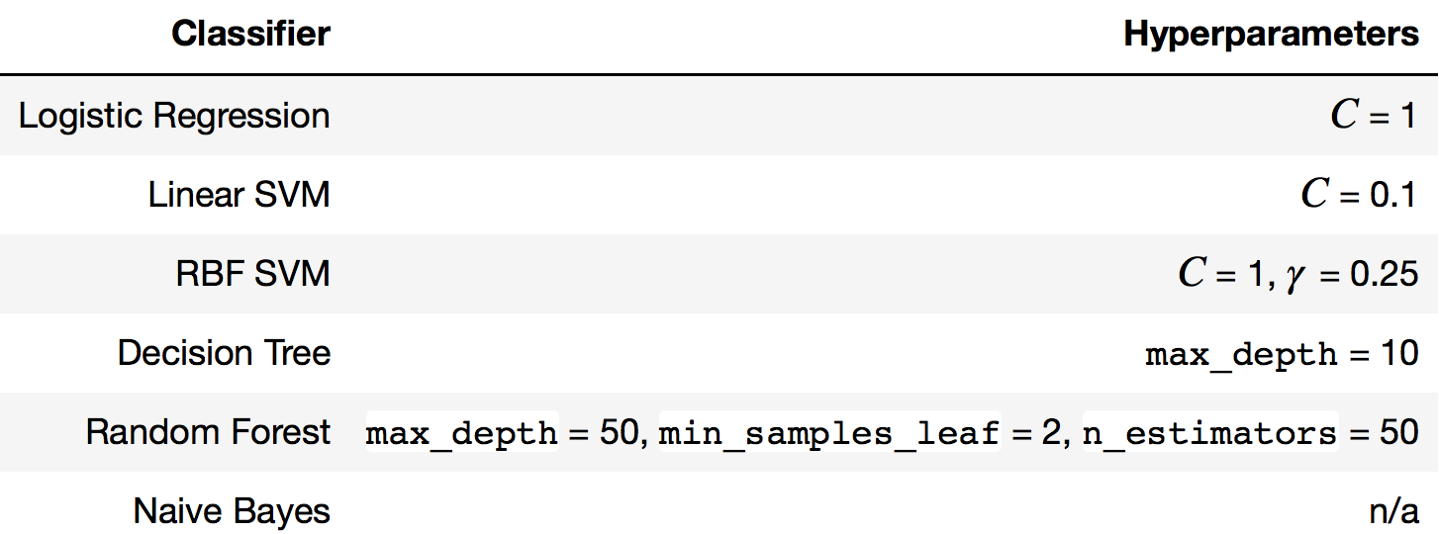
Algorithms
Tuned hyperparameters using gridsearch 5-fold cross validation

Slide 13
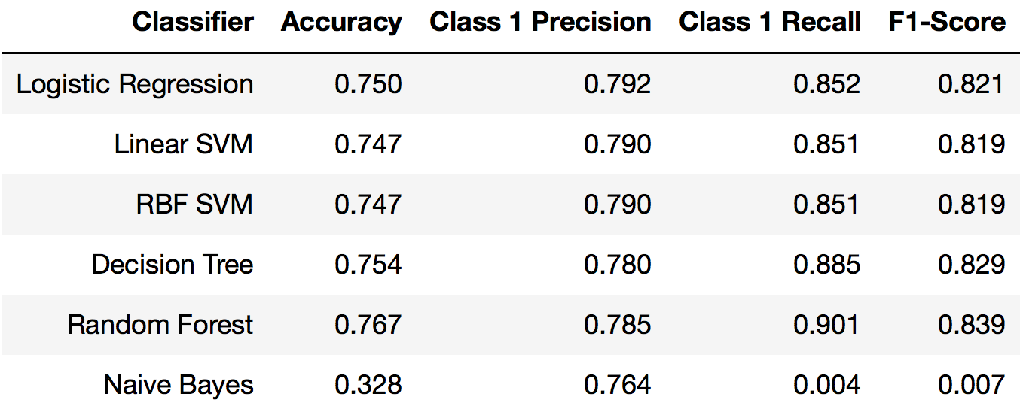
Model Evaluation

Slide 14
Limitations
Possible unknown pattern (e.g., period of time, geographical area, citing officers) to the records that lacked Lat, Lon information.
No date-of-payment field available.
Cannot be more specific about timing of payments beyond that 67% of citations were paid within two years.

Slide 15
Recommendations to Clients
City Treasury Budget items that are funded by parking citation revenues should be budgeted no more than one-quarter in advance using the random forest classifier to predict the revenue the city can expect.
City Planners Develop a mobile app for paying meters remotely.
Alternatively, use a centralized system so meters can be paid from any machine across the city.
City Planners Designate more spaces with a 30-60 minute limit during lunch hours, forcing turnover so more spaces will be available.

Slide 16
Acknowledgements
Springboard
My mentor, Justin Breucop
Open Baltimore (https://data.baltimorecity.gov)

